Slide 1
Lecture 11
Major Combinational Automatic Test-Pattern Generation Algorithms
Definitions
D-Algorithm (Roth) -- 1966
  D-cubes
  Bridging faults
  Logic gate function change faults
PODEM (Goel) -- 1981
  X-Path-Check
  Backtracing
Summary

Slide 2
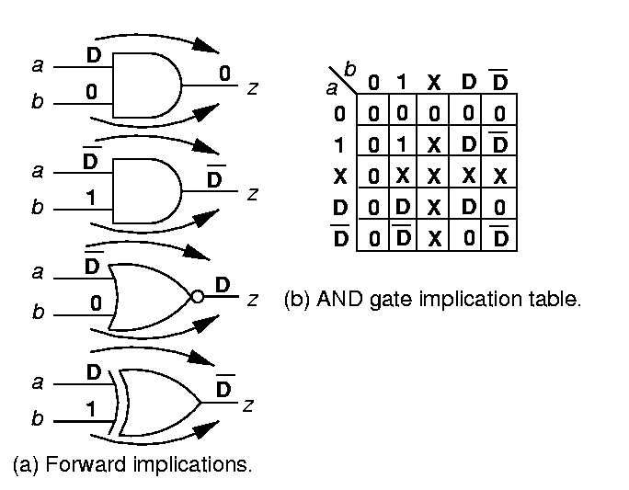
Forward Implication
Results in logic gate inputs that are significantly labeled so that output is uniquely determined
AND gate forward implication table:

Slide 3
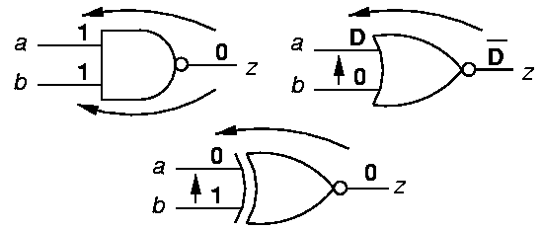
Backward Implication
Unique determination of all gate inputs when the gate output and some of the inputs are given

Slide 4
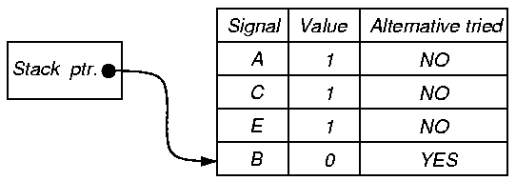
Implication Stack
Push-down stack. Records:
  Each signal set in circuit by ATPG
  Whether alternate signal value already tried
  Portion of binary search tree already searched

Slide 5
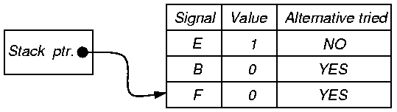
Implication Stack after Backtrack
Unexplored
Present Assignment
Searched and Infeasible
0
E
1
B
B
0
1
0
1
F
F
F
0
1
0
1
0
1

Slide 6
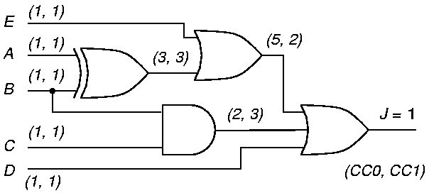
Objectives and Backtracing of ATPG Algorithm
Objective – desired signal value goal for ATPG
  Guides it away from infeasible/hard solutions
Backtrace – Determines which primary input and value to set to achieve objective
  Use testability measures

Slide 7
Branch-and-Bound Search
Efficiently searches binary search tree
Branching – At each tree level, selects which input variable to set to what value
Bounding – Avoids exploring large tree portions by artificially restricting search decision choices
  Complete exploration is impractical
  Uses heuristics

Slide 8
D-Algorithm -- Roth
IBM
(1966)
Fundamental concepts invented:
  First complete ATPG algorithm
  D-Cube
  D-Calculus
  Implications – forward and backward
  Implication stack
  Backtrack
  Test Search Space

Slide 9
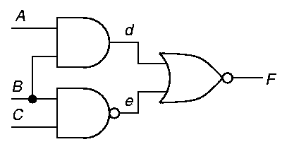
Singular Cover Example
Minimal set of logic signal assignments to show essential prime implicants of Karnaugh map
Gate
AND
1
2
3
Inputs
A
0
X
1
Output
d
0
0
1
Gate
NOR
1
2
3
Inputs
d
1
X
0
Output
F
0
0
1
B
X
0
1
e
X
1
0

Slide 10
D-Cube
Collapsed truth table entry to characterize logic
Use Roth’s 5-valued algebra
Can change all D’s to D’s and D’s to D’s (do both)
AND gate:
A
D
1
D
D
1
D
B
1
D
D
D
D
1
d
D
D
D
D
D
D
Rows 1 & 3
Reverse inputs
And two cubes
Interchange D and D

Slide 11
D-Cube Operation of
D-Intersection
ψ – undefined (same as φ)
μ or λ – requires inversion of D and D
D-intersection: 0 0 = 0 X = X 0 = 0
1 1 = 1 X = X 1 = 1
X X = X
D-containment –
  Cube a contains
  Cube b if b is a
  subset of a
0
1
X
D
D
0
0
φ
0
ψ
ψ
1
φ
1
1
ψ
ψ
X
0
1
X
D
D
D
ψ
ψ
D
μ
λ
D
ψ
ψ
D
λ
μ

Slide 12
Primitive D-Cube of Failure
Models circuit faults:
  Stuck-at-0
  Stuck-at-1
  Bridging fault (short circuit)
  Arbitrary change in logic function
AND Output sa0: “1 1 D”
AND Output sa1: “0 X D ”
  “X 0 D ”
Wire sa0: “D”
Propagation D-cube – models conditions under which fault effect propagates through gate

Slide 13
Implication Procedure
Model fault with appropriate primitive D-cube of failure (PDF)
Select propagation D-cubes to propagate fault effect to a circuit output (D-drive procedure)
Select singular cover cubes to justify internal circuit signals (Consistency procedure)
Put signal assignments in test cube
Regrettably, cubes are selected very arbitrarily by D-ALG

Slide 14
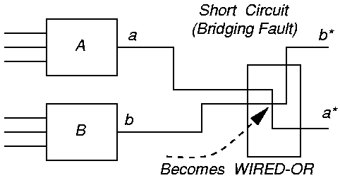
Bridging Fault Circuit

Slide 15
Construction of Primitive
D-Cubes of Failure
Make cube set α1 when good machine output is 1 and set α0 when good machine output is 0
Make cube set β1 when failing machine output is 1 and β0 when it is 0
Change α1 outputs to 0 and D-intersect each cube with every β0. If intersection works, change output of cube to D
Change α0 outputs to 1 and D-intersect each cube with every β1. If intersection works, change output of cube to D

Slide 16
Bridging Fault D-Cubes of Failure
Cube-set
α0
α1
β0
β1
a
0
X
1
X
0
X
1
b
X
0
X
1
0
1
X
a*
0
X
1
X
0
1
1
b*
X
0
X
1
0
1
1
Cube-set
PDFs for
Bridging fault
a
1
0
b
0
1
a*
1
D
b*
D
1

Slide 17

Gate Function Change D-Cube of Failure
Cube-set
α0
α1
β0
β1
a
0
X
1
0
1
X
b
X
0
1
0
X
1
c
0
0
1
0
1
1
Cube-set
PDFs for
AND changing
to OR
a
0
1
b
1
0
c
D
D

Slide 18
D-Algorithm – Top Level
Number all circuit lines in increasing level order from PIs to POs;
Select a primitive D-cube of the fault to be the test cube;
  Put logic outputs with inputs labeled as D (D) onto the D-frontier;
D-drive ();
Consistency ();
return ();

Slide 19
D-Algorithm – D-drive
while (untried fault effects on D-frontier)
  select next untried D-frontier gate for propagation;
  while (untried fault effect fanouts exist)
    select next untried fault effect fanout;
    generate next untried propagation D-cube;
    D-intersect selected cube with test cube;
    if (intersection fails or is undefined) continue;
    if (all propagation D-cubes tried & failed) break;
    if (intersection succeeded)
      add propagation D-cube to test cube -- recreate D-frontier;
      Find all forward & backward implications of assignment;
      save D-frontier, algorithm state, test cube, fanouts, fault;
      break;
    else if (intersection fails & D and D in test cube) Backtrack ();
    else if (intersection fails) break;
  if (all fault effects unpropagatable) Backtrack ();

Slide 20
D-Algorithm -- Consistency
g = coordinates of test cube with 1’s & 0’s;
if (g is only PIs) fault testable & stop;
for (each unjustified signal in g)
  Select highest # unjustified signal z in g, not a PI;
  if (inputs to gate z are both D and D) break;
  while (untried singular covers of gate z)
    select next untried singular cover;
    if (no more singular covers)
      If (no more stack choices) fault untestable & stop;
      else if (untried alternatives in Consistency)
        pop implication stack -- try alternate assignment;
      else
        Backtrack ();
        D-drive ();
    If (singular cover D-intersects with z) delete z from g, add inputs to singular cover to g, find all forward and backward implications of new assignment, and break;
    If (intersection fails) mark singular cover as failed;

Slide 21
Backtrack
if (PO exists with fault effect) Consistency ();
else pop prior implication stack setting to try alternate assignment;
if (no untried choices in implication stack)
  fault untestable & stop;
else return;

Slide 22
Circuit Example 7.1 and Truth Table
Inputs
a
0
0
0
0
1
1
1
1
Output
F
0
0
0
1
0
0
0
0
b
0
0
1
1
0
0
1
1
c
0
1
0
1
0
1
0
1

Slide 23
Singular Cover & D-Cubes
A
1
0
D
1
D
B
1
0
1
0
1
D
D
D
1
D
C
1
0
1
D
D
d
1
0
0
1
0
D
D
D
D
0
D
e
0
1
1
1
0
D
D
D
0
D
D
F
0
0
1
D
D
D
Singular cover – Used for justifying lines
Propagation D-cubes – Conditions under which difference between good/failing machines propagates

Slide 24
Steps for Fault d sa0
Step
1
2
3
A
1
B
1
1
C
1
d
D
D
e
0
0
F
D
Cube type
PDF of AND gate
Prop. D-cube for NOR
Sing. Cover of NAND

Slide 25
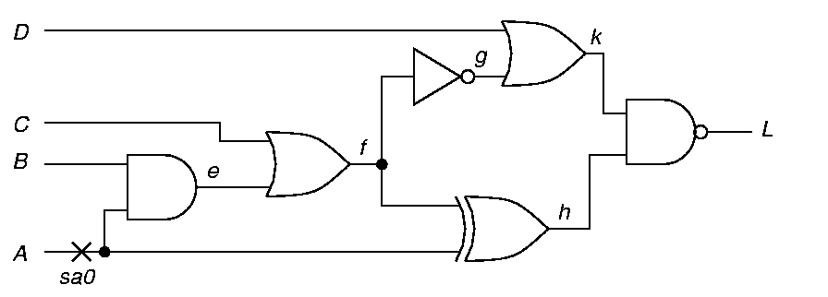
Example 7.2 Fault A sa0
Step 1 – D-Drive – Set A = 1
D
1
D

Slide 26
Step 2 -- Example 7.2
Step 2 – D-Drive – Set f = 0
0
D
D
1
D

Slide 27
Step 3 -- Example 7.2
Step 3 – D-Drive – Set k = 1
1
D
0
D
D
1
D

Slide 28
Step 4 -- Example 7.2
Step 4 – Consistency – Set g = 1
1
1
D
0
D
D
1
D

Slide 29
Step 5 -- Example 7.2
Step 5 – Consistency – f = 0 Already set
1
1
D
0
D
D
1
D

Slide 30
Step 6 -- Example 7.2
Step 6 – Consistency – Set c = 0, Set e = 0
1
1
0
D
0
0
D
D
1
D

Slide 31
D-Chain Dies -- Example 7.2
Step 7 – Consistency – Set B = 0
D-Chain dies
X
1
1
0
D
0
0
0
D
D
1
D
Test cube: A, B, C, D, e, f, g, h, k, L

Slide 32
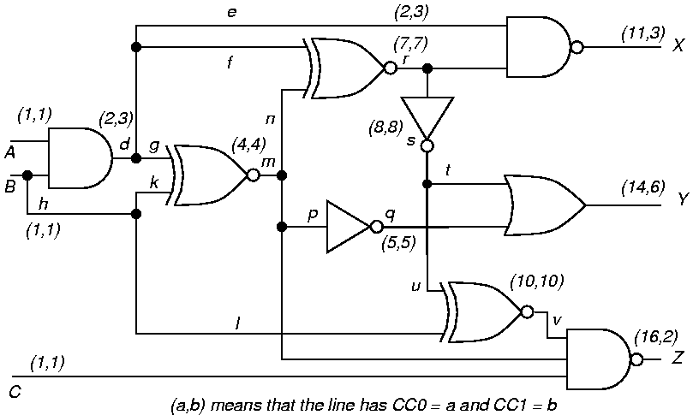
Example 7.3 – Fault s sa1
Primitive D-cube of Failure
1
D
sa1

Slide 33
Example 7.3 – Step 2 s sa1
Propagation D-cube for v
1
D
1
sa1
D
0
D

Slide 34
Example 7.3 – Step 2 s sa1
Forward & Backward Implications
0
1
1
1
1
D
1
sa1
D
0
D

Slide 35
Example 7.3 – Step 3 s sa1
Propagation D-cube for Z – test found!
0
1
1
1
1
D
1
sa1
D
0
D
D
1

Slide 36
Example 7.3 – Fault u sa1
Primitive D-cube of Failure
1
0
sa1
D

Slide 37
Example 7.3 – Step 2 u sa1
Propagation D-cube for v
1
0
0
sa1
D
D

Slide 38
Example 7.3 – Step 2 u sa1
Forward and backward implications
1
1
0
0
1
0
0
0
sa1
D
D

Slide 39
Inconsistent
d = 0 and m = 1 cannot justify r = 1 (equivalence)
  Backtrack
  Remove B = 0 assignment

Slide 40
Example 7.3 – Backtrack
Need alternate propagation D-cube for v
1
0
sa1
D

Slide 41
Example 7.3 – Step 3 u sa1
Propagation D-cube for v
1
1
0
sa1
D
D

Slide 42
Example 7.3 – Step 4 u sa1
Propagation D-cube for Z
1
1
1
0
sa1
D
D
D
1

Slide 43
Example 7.3 – Step 4 u sa1
Propagation D-cube for Z and implications
0
1
1
1
1
1
0
0
0
sa1
D
D
D
1

Slide 44
PODEM -- Goel
IBM
(1981)
New concepts introduced:
  Expand binary decision tree only around primary inputs
  Use X-PATH-CHECK to test whether D-frontier still there
  Objectives -- bring ATPG closer to propagating D (D) to PO
  Backtracing

Slide 45
Motivation
IBM introduced semiconductor DRAM memory into its mainframes – late 1970’s
Memory had error correction and translation circuits – improved reliability
  D-ALG unable to test these circuits
    Search too undirected
    Large XOR-gate trees
    Must set all external inputs to define output
  Needed a better ATPG tool

Slide 46
PODEM High-Level Flow
Assign binary value to unassigned PI
Determine implications of all PIs
Test Generated? If so, done.
Test possible with more assigned PIs? If maybe, go to Step 1
Is there untried combination of values on assigned PIs? If not, exit: untestable fault
Set untried combination of values on assigned PIs using objectives and backtrace. Then, go to Step 2

Slide 47
Example 7.3 Again
Select path s – Y for fault propagation
sa1

Slide 48
Example 7.3 -- Step 2 s sa1
Initial objective: Set r to 1 to sensitize fault
1
sa1

Slide 49
Example 7.3 -- Step 3 s sa1
Backtrace from r
1
sa1

Slide 50
Example 7.3 -- Step 4 s sa1
Set A = 0 in implication stack
1
0
sa1

Slide 51
Example 7.3 -- Step 5 s sa1
Forward implications: d = 0, X = 1
1
1
0
0
sa1

Slide 52
Example 7.3 -- Step 6 s sa1
Initial objective: set r to 1
1
1
0
0
sa1

Slide 53
Example 7.3 -- Step 7 s sa1
Backtrace from r again
1
1
0
0
sa1

Slide 54
Example 7.3 -- Step 8 s sa1
Set B to 1. Implications in stack: A = 0, B = 1
1
1
0
0
1
sa1

Slide 55
Example 7.3 -- Step 9 s sa1
Forward implications: k = 1, m = 0, r = 1, q = 1, Y = 1, s = D, u = D, v = D, Z = 1
1
1
0
0
1
0
sa1
D
1
1
1
D
D
1

Slide 56
Backtrack -- Step 10 s sa1
X-PATH-CHECK shows paths s – Y and s – u – v – Z blocked (D-frontier disappeared)
1
1
0
0
sa1

Slide 57
Step 11 -- s sa1
Set B = 0 (alternate assignment)
1
0
0
sa1

Slide 58
Backtrack -- s sa1
Forward implications: d = 0, X = 1, m = 1, r = 0,
s = 1, q = 0, Y = 1, v = 0, Z = 1. Fault not sensitized.
1
0
0
0
1
0
1
sa1
1
0
1
0
1

Slide 59
Step 13 -- s sa1
Set A = 1 (alternate assignment)
1
1
sa1

Slide 60
Step 14 -- s sa1
Backtrace from r again
1
1
sa1

Slide 61
Step 15 -- s sa1
Set B = 0. Implications in stack: A = 1, B = 0
1
1
0
sa1

Slide 62
Backtrack -- s sa1
Forward implications: d = 0, X = 1, m = 1, r = 0. Conflict: fault not sensitized. Backtrack
1
0
1
0
1
0
sa1
1
1
0
1
0
1

Slide 63
Step 17 -- s sa1
Set B = 1 (alternate assignment)
1
1
1
sa1

Slide 64
Fault Tested -- Step 18 s sa1
Forward implications: d = 1, m = 1, r = 1, q = 0, s = D, v = D, X = 0, Y = D
0
1
1
1
1
1
sa1
D
D
0
D
D
X

Slide 65
Backtrace (s, v_{s})
Pseudo-Code
v = v_{s};
while (s is a gate output)
  if (s is NAND or INVERTER or NOR) v = v;
  if (objective requires setting all inputs)
    select unassigned input a of s with hardest controllability to value v;
  else
    select unassigned input a of s with easiest controllability to value v;
  s = a;
return (s, v) /* Gate and value to be assigned */;

Slide 66
Objective Selection Code
if (gate g is unassigned) return (g, v);
select a gate P from the D-frontier;
select an unassigned input l of P;
if (gate g has controlling value)
  c = controlling input value of g;
else if (0 value easier to get at input of XOR/EQUIV gate)
  c = 1;
else c = 0;
return (l, c );

Slide 67
PODEM Algorithm
while (no fault effect at POs)
  if (xpathcheck (D-frontier)
    (l, v_{l}) = Objective (fault, v_{fault});
    (pi, v_{pi}) = Backtrace (l, v_{l});
    Imply (pi, v_{pi});
    if (PODEM (fault, v_{fault}) == SUCCESS) return (SUCCESS);
    (pi, v_{pi}) = Backtrack ();
    Imply (pi, v_{pi});
    if (PODEM (fault, v_{fault}) == SUCCESS) return (SUCCESS);
    Imply (pi, “X”);
    return (FAILURE);
  else if (implication stack exhausted)
    return (FAILURE);
  else Backtrack ();
return (SUCCESS);

Slide 68
Summary
D-ALG – First complete ATPG algorithm
  D-Cube
  D-Calculus
  Implications – forward and backward
  Implication stack
  Backup
PODEM
  Expand decision tree only around PIs
  Use X-PATH-CHECK to see if D-frontier exists
  Objectives -- bring ATPG closer to getting
  D (D) to PO
  Backtracing

